Slide 1
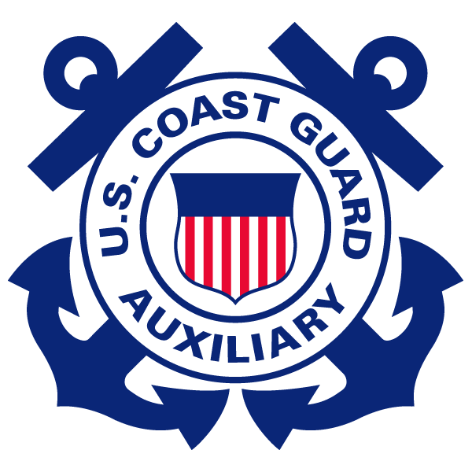
Suddenly in Command!
What now?
Notes:
This is a 2-4 hour boating safety seminar, written by Dr. L. Daniel Maxim, ANACO-RB, and John VanOsdol, DIR-Ed, to assist boat occupants who are not normally at the helm, including guests, spouses, children, or others aboard who may find themselves “suddenly in command” if the operator becomes ill, gets injured, falls overboard, or has to attend to some other emergency and is unable to be at the helm. We also owe a debt of thanks to many Auxiliarists who offered helpful comments on the course.
The purpose of this short course is to familiarize the student with essential safety information so they can assess and stabilize the situation, operate the vessel, and summon any required assistance.
While this slide remains on the screen, instructors should introduce themselves and ask the students to do the same. Ask also if any of the students has had the experience of being suddenly in command and to share any relevant stories.
Disclaimer: The appearance of any product or service advertisement on the site to which any link in the notes for this presentation is directed does not constitute, and shall not be construed as, an endorsement of that product or service by the United States Coast Guard or Coast Guard Auxiliary.

Slide 2
Outline of Presentation
1
Introduction
2
Preparation/prevention
3
Response
4
Summary and closing comments
Notes:
Explain briefly the contents of each of these major blocks. Note that this is a classroom, not an on-water course. That is, the course covers the things you should know, but does not give you actual underway experience.

Slide 3
introduction

Slide 4
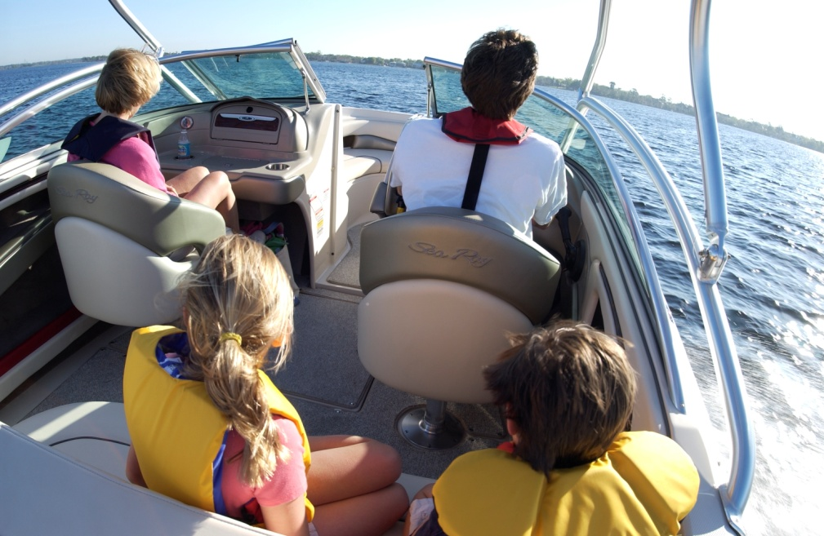
Perspective
Fortunately, recreational boating is relatively safe
But we can make it safer
Skipper incapacitation is rare, but could be dangerous
Notes:
The overall fatality rate for recreational boats for the year 2011 is 25.5 per 100 million exposure hours. Exposure hours data are derived from the National Recreational Boating Survey. Fatality data are derived from the Boating Accident Report Database (BARD). This is an overall fatality rate—it is higher for some boat types (e.g., paddlecraft) and lower for others (e.g., pontoon boats). We don’t have accurate data on the frequency of boat skipper incapacitation (but see below), but there are published accident reports for both boats and aviation (see e.g., http://avherald.com/h?article=45d14284, http://www.avweb.com/news/safety/183023-1.html, http://www.dailymail.co.uk/news/article-2235746/Passenger-steps-land-747-pilot-falls-ill--happens-duty-pilot.html, http://www.maib.gov.uk/cms_resources.cfm?file=/LionReport.pdf, and http://www.americanboating.org/suddenlyincommand.asp) that indicate that this situation does occur—sometimes with disastrous consequences. Moreover, the fact that the skipper is incapacitated should not mean that others should be at risk. For the year 2011 ‘sudden medical condition’ was listed as a ‘primary contributing factor’ in 0.7% of the accidents, 4.3% of fatalities, and 0.17% of the injuries. As a point of interest, concern over skipper incapacitation is one of the reasons why there are two qualified pilots on board commercial aircraft. There are some data on US airline pilot incapacitation, see http://www.skybrary.aero/index.php/In-flight_Pilot_Incapacitation_(OGHFA_SE) and http://www.skybrary.aero/index.php/Crew_Incapacitation. Image from US Coast Guard at http://www.uscgboating.org/assets/gallery/image/original/03_05_1_1B_0035.JPG.

Slide 5
You might find yourself in command if
Your skipper falls overboard
Your skipper becomes physically incapacitated (e.g., injury, seasickness or other medical condition)
Your skipper needs to attend to some pressing emergency
What now? Would you know what to do?
Notes:
These are the principal circumstances that might require non-operators to assume command. Here are excerpts from four cases in the boating accident report database:
WI-2012-0097: After drinking heavily throughout the day, the boat operator-victim was sitting on the stern, and operating his boat at slow no wake speed, when he fell overboard. One passenger jumped into the lake to help while the remaining two passengers remained aboard. One passenger turned the engine off shortly after the operator fell overboard. No one aboard knew how to start the motor. They used paddles to move the boat back to location of second subject who had been searching for the victim. After retrieving second subject, the passengers paddled the boat to a nearby dock. The operator drowned.
2009-CO-0020: Vessel was running on a trolling motor when victim jumped overboard to retrieve a lost fishing rod without a pfd. Passenger did not know how to operate vessel back to victim. Victim had drowned before anyone could respond to his location.
OH-2010-0096: The operator of the vessel with two additional persons on board was forced to use its auxiliary engine due to choppy waters near Port Clinton. The line from the jib sail then accidentally wrapped around the prop. The operator entered the water to attempt to cut the line, however the vessel drifted away from him in the rough water. The occupants still aboard the vessel did not know how to operate it and were unable to assist the operator. The operator/victim went under shortly thereafter and did not resurface. A search for the Victim was unsuccessful. The Victim's body was recovered on July 26, 2010.
2007-MT-0016: Operator and 2 passengers in vessel were cruising downstream on the Flathead River when they encountered a wake left from another boat traveling in the opposite direction approx. 30-60 seconds prior. When they hit the wake, it caused the boat to bounce and turn in a sharp circle to the right. The operator and adult female passenger were ejected from the boat leaving an 11 year old female passenger in the boat while it drove around in circles. The operator swam to the unconscious female and attempted to revive her. He yelled at the 11 year old passenger to shut the boat down, which she did not know how to do, but she finally got the boat stopped. With the help of another boat that came by several minutes later, they were able to pick up the two people in the water and return to shore. Upon being ejected, the adult female passenger was struck by the prop causing severe lacerations and fractures to the arm and skull.

Slide 6
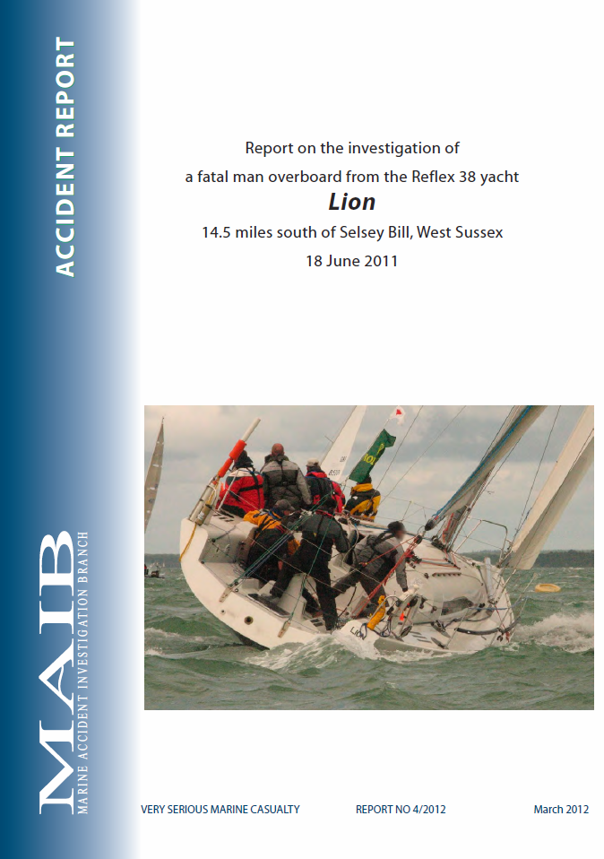
Unlikely, but not impossible
18 June 2011, Lion skipper fell overboard
It took the crew 16 minutes to recover the skipper, where he was pronounced dead by a physician aboard
Failure to name a replacement skipper slowed the speed of recovery
Notes:
The complete Marine Accident Investigation Branch (MAIB) [the UK equivalent of the US NTSB] report on this case is available from http://www.maib.gov.uk/cms_resources.cfm?file=/LionReport.pdf. This case is relevant because it underscores the need for the skipper to nominate a “relief skipper” in the event that he/she is incapacitated. In this case valuable time was lost after the skipper fell overboard because no one knew who was in charge. This should be a normal part the pre-underway briefing.

Slide 7
Unlikely, but not impossible
August 2001: Captain of F/V Heritage became unconscious and died
Believing that the Captain was in a diabetic coma, members of the crew started CPR
Distracted, the crew lost situational awareness, and the vessel ran aground
Notes:
A news article on this case is available at http://juneauempire.com/stories/082701/Loc_skipper.shtml. In this case the crew lost situational awareness because they were preoccupied with trying to assist the skipper. This preoccupation meant that the crew lost situational awareness; no one paid attention to the fact that the ship was in danger of running aground. In the end, the vessel was able to be refloated without damage, but had the coast been rocky the vessel (and other lives) might have been lost as well.

Slide 8
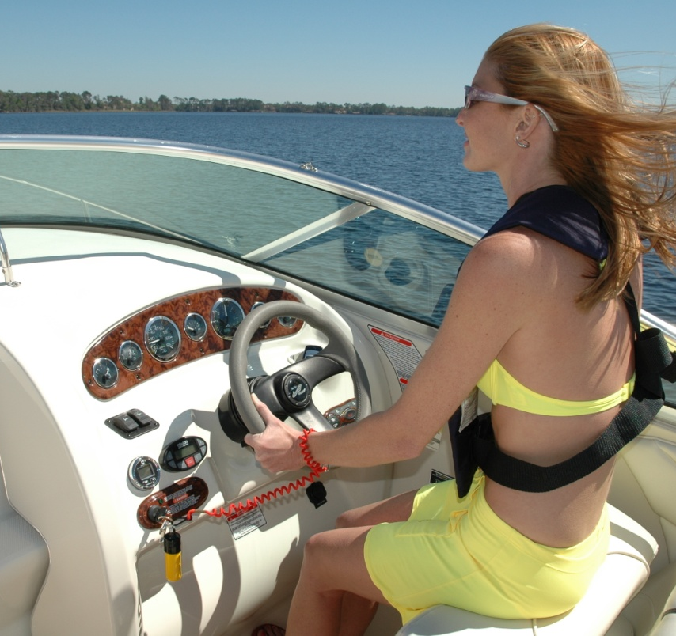
Are you prepared?
Do you have a designated ‘relief skipper?’
Can you assess the situation and decide what needs to be done?
Do you know how to start/stop/maneuver or anchor the boat?
Notes:
These are illustrative questions to ask of the students. This is not an exhaustive list of questions; it is intended to stimulate thought and discussion. The photo source is the US Coast Guard (http://www.uscgboating.org/assets/gallery/image/original/03_05_1_2A_0099.JPG).

Slide 9

Are you prepared?
Have you ever practiced a man-overboard situation?
Do you have accessible checklists for various emergencies?
Do you have a training program for various emergencies?
Have you conducted emergency drills?
Notes:
This continues the first list of questions. It also identifies the topics to be covered in the class.

Slide 10
Are you prepared?
Do you know your location? (Do you know how to determine your location?)
Do you know who and how to call for help on the water?
Notes:
This continues the first list of questions. It also identifies the topics to be covered in the class.

Slide 11
Are you prepared?
Did you file a float plan? (Will someone come looking for you?)
Do you know the location of all emergency gear?
Notes:
Here is a web site address to get a USCG float plan; http://www.floatplancentral.org/download/USCGFloatPlan.pdf. Time permitting, go over the contents of the float plan with the class.

Slide 12
The pilot’s mantra
‘Aviate, Navigate, Communicate’
  Get/keep the aircraft/vessel under control
  Know where you are, where you are going, and how to get there
  Communicate your situation to those who can offer help
Notes:
Aviators use this phrase to help prioritize what needs to be done in any emergency—including a permanent or temporary loss of the skipper. It applies equally to boats as to airplanes.
The word ‘aviate’ reminds us that we need to keep the boat under control. Depending upon the circumstances, the best option for a boat would be to throttle down and take it out of gear (not an option for aircraft) and use the time to figure out what to do next.
The word ‘navigate’ reminds us that we need to know where we are and how to get to a harbor safely. At a minimum, knowledge of your position enables you to get help efficiently. It is difficult to summon help if you don’t know where you are.
The word ‘communicate’ means that, depending upon the situation, you may need to summon help. Therefore, you need to know how to do this using whatever means are available such as a marine radio or a cell phone.
Other web sites that address the ANC sequence include:
http://www.speakermatch.com/topics/motivation/3840/aviate-navigate-communicate/
http://aviation.ou.edu/SafetyCorner/documents/March2012AviationSafetyCorner-Aviate.pdf
https://www.faasafety.gov/gslac/ALC/course_content.aspx?cID=40
http://www.hf.faa.gov/docs/508/docs/gaPriorityReport.pdf.

Slide 13

A short video
Notes:
This short video was prepared by, and used with the permission of the Canadian Safe Boating Council (CSBC). It provides a nice illustration of some of the key things you need to know in the event the skipper becomes incapacitated. Channel 16 is the international calling and distress frequency for marine VHF radio. However, *16 does not work in the United States. The US had a similar service at one time ‘*CG,’ but has discontinued this service in all states but Alaska. (The *CG feature was introduced by some cellular communications companies in the early 1990’s, but never developed into a nationwide service. As wireless providers moved to digital systems, some didn't migrate *CG to the new system and others even lost track of whether or not they were continuing the feature. This patchwork of service is confusing for the mariners who choose to use it, and may, in fact, prevent them from making a timely call for assistance should they find themselves in an area where *CG is not available.) ‘*16’ is still in use in Canada (see http://www.ccg-gcc.gc.ca/eng/CCG/SAR_Adr or http://www.ccg-gcc.gc.ca/eng/MCTS/Cell). In waters covered by the Coast Guard the marine radio is the preferred method for distress calls. You can use ‘911’ on your cell phone to summon assistance, but most 911 operators are not trained to handle marine emergencies.

Slide 14
Preparation/prevention
Notes:
Preparation/prevention is the major theme of this seminar.

Slide 15
Why important?
Stay calm, but how?
  The best advice is to be well prepared, trained, and experienced (with drills) in advance
  Checklists help to ‘routinize’ exceptional events
Notes:
It’s normal for people to feel anxious when an emergency occurs, such as incapacitation of the skipper. People are also vulnerable to panic (a sudden sensation, which is strong enough to dominate or present reason and logical thinking), which can be infectious. Merely telling people to ‘stay calm’ is probably not all that helpful, although it can’t hurt. It’s more useful advice to prepare for emergencies with training, drills, and emergency checklists. Checklists not only help you to remember tasks that you might otherwise forget, but also help to reduce anxiety, because they routinize otherwise exceptional events. As noted by physician Atul Gawande, author of a book The Checklist Manifesto, a checklist helps reduce panic in unfamiliar situations and allows everyone involved to know exactly what is expected of them. As noted by the FAA in a document discussing checklist design, “It [the checklist] is an important aid in helping the crew to remain focused to the task at hand by eliminating guesswork that often accompanies periods when crew attention is divided especially during periods of stress or fatigue. The checklist is an important and necessary backup for the pilot and crew.” See
http://www.faa.gov/about/office_org/headquarters_offices/avs/offices/afs/afs200/branches/afs210/training_aids/media/checklist.doc.

Slide 16
Checklists
Checklists are important for both normal procedures and emergencies
You should also have a checklist for skipper incapacitation
What would you put on this checklist?
Notes:
There are several sources for checklists. Here is a sample:
http://www.sdfsa.net/pdf/EmergProc-A_Boat%20Operator.pdf. Suggested checklists are included in the documentation for this course and can be reviewed in class, time permitting.

Slide 17
“I’m Safe” for skippers
A personal checklist for skipper (and crew) before departure:
  Illness
  Medication
  Stress
  Alcohol
  Fatigue
  Eating
Notes:
The “I’m safe” mental checklist is used by aviators as a personal checklist to evaluate fitness for flying (see e.g., http://www.leftseat.com/imsafe.htm, http://en.wikipedia.org/wiki/IMSAFE, http://www.capmembers.com/media/cms/IMSAFE_Checklist_318E33C36BD7F.pdf, https://www.faasafety.gov/gslac/ALC/course_content.aspx?cID=49&sID=293&preview=true, and http://download.aopa.org/epilot/2008/8083-25-chap16.pdf). Some sources substitute ‘emotion’ for ‘eating’ as the ‘E’ in I’m Safe. For more detail see http://www.faa.gov/regulations_policies/handbooks_manuals/aviation/pilot_handbook/media/PHAK%20-%20Chapter%2016.pdf. Provide students with a brief discussion of each of these factors and how they can impact the fitness of the skipper (and crew for that matter).

Slide 18
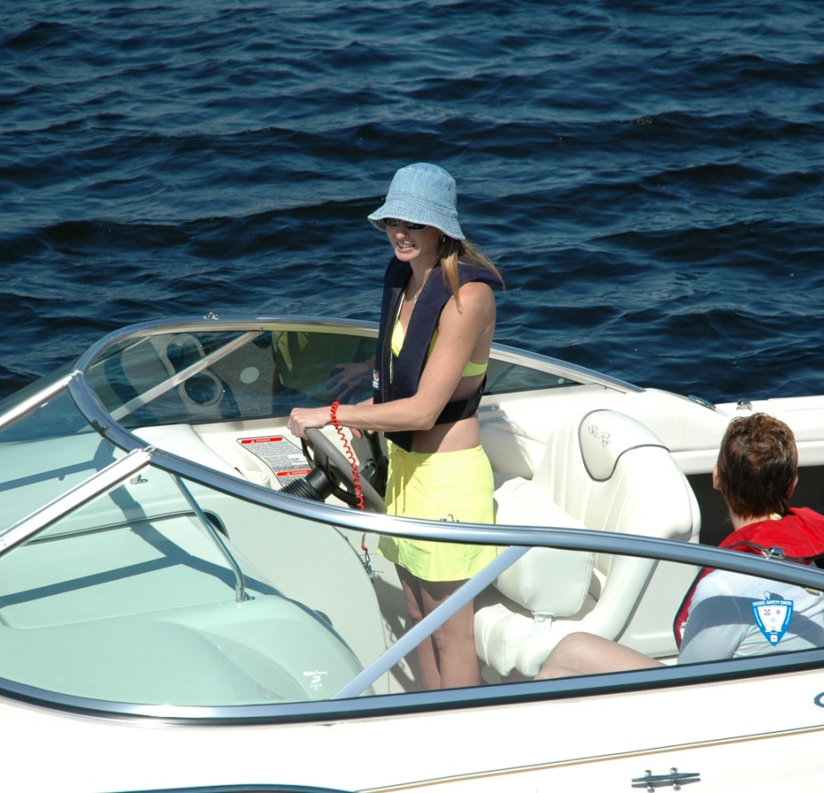
Training/Practice
An actual emergency is not the time to learn!
Define a set of tasks you need to know
Conduct regular training sessions on these tasks
Notes:
Training others to cope with SIC situations is not only good practice, but can add enjoyment to the voyage. Every trip has some ‘dead time’ or free time that can be used for short training sessions. Training sessions add to everyone’s interest and also instill confidence. The training should include use of checklists as well as ‘hand’s on’ training in boat handling. Useful tasks to cover include stopping, starting, maneuvering, determining your position, and use of the radio. Find a ‘practice area’ free of traffic and navigational hazards for these sessions. Though ‘perfection’ might be nice, the aim is to teach relief skippers to reach a level of competence in maneuvers sufficient to ensure safety. Relief skippers do not need perfection in docking, for example, as long as they can approach the dock sufficiently slowly to avoid significant impact—those on shore can provide assistance in securing the vessel. This said, you might be pleasantly surprised to find that your ‘first mate’ wishes to learn more and become really proficient.

Slide 19
Operating the boat
You should have a basic ability to operate the boat
  Throttle(s) and gearshift(s) and operation
  How to start and stop the engine
  How to steer the boat
  How to anchor the boat
  How to operate mechanical and non-mechanical bilge pumps
Notes:
There are different throttle and gearshift combinations. These can be covered in the on-the-water training sessions specific to each boat. This class is aimed at those in powerboats. Instructors who are sailors should supplement the material in this course if they are teaching fellow sailors.

Slide 20
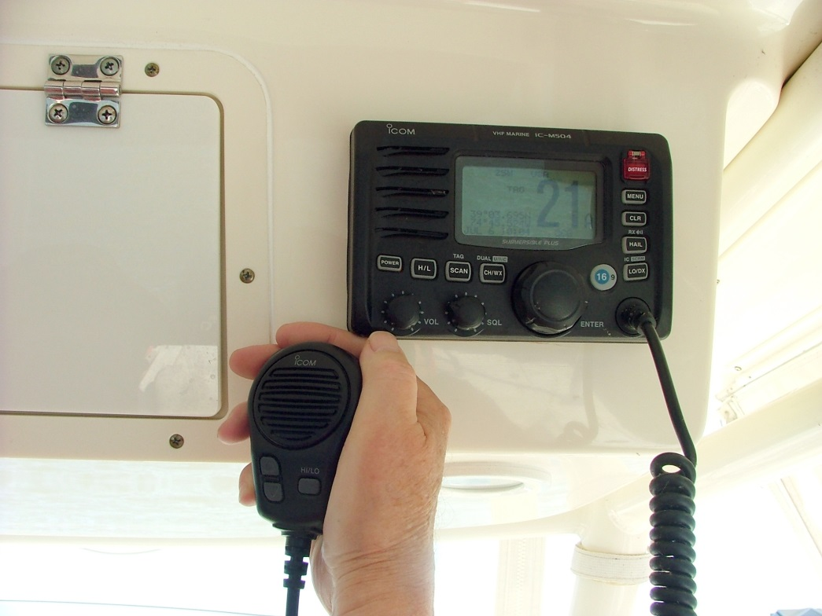
Operating the boat
You should also be familiar with the gauges and instruments—particularly the radio and GPS
Practice is essential
Notes:
This photo was taken by Joseph Giannattasio Public Affairs Specialist III (PA III) District 5NR. The radio in this picture is set to channel 21, but normally the public would communicate with the Coast Guard on Channel 22 A after initial contact on Channel 16.

Slide 21
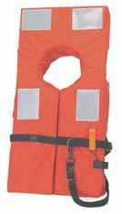
Safety equipment
Know location and function of all safety equipment, e.g.,
  Fire extinguishers
  Life jackets
  Flares
  De-watering equipment
  Anchor
  First aid kit
Courtesy Personal Flotation Device Manufacturers Association
Notes:
The pre-underway checklist should include these items. It is helpful if this checklist identifies the locations where these items are kept. The skipper should go over the pre-underway checklist with the passengers, so they are well briefed.

Slide 22
Medical treatment
This course does not cover medical treatment, but it would be useful to know:
  First aid
  CPR
The skipper and crew should make everyone aware of any known medical conditions and necessary medications
Notes:
The Auxiliary provides instruction to its members on basic first aid and some Auxiliarists are medically trained. However, we are not trained to give instruction to the public on treatment for medical emergencies. Just suggest that the students have a basic first aid kit available on their boats and take first aid and CPR courses from authorized providers.

Slide 23
More on medical issues
Even though this course omits first aid or other medical treatment you should
  Be aware of any pre-existing medical conditions of the skipper
  Ensure that any emergency medications that might be needed are available
Notes:
This is ultimately the skipper’s responsibility. Nonetheless, this might be included on a checklist.

Slide 24
Drills
In addition to training sessions, it is useful to have drills on emergencies of various types—for skipper and crew alike
What drills would you suggest?
Notes:
Use this as an open-ended question. We have a suggested list following.

Slide 25
Recommended drills
Subject of drills
Types of drills
Man overboard and recovery
Communications
Use of distress signals
Fire
Collision
Grounding
Talk through (discussion)
Walk through (simulation)
Use both types
Notes:
We do not have data on the total number of man overboard cases because (fortunately) not all man overboard situations lead to reportable accidents, fatalities or injuries. In 2012, falls overboard accounted for 197 out of 651 (30.3%) of reported fatalities and 157 out of 3000 (5.2%) of all injuries among reportable recreational boating accidents. Knowing how to recover a man overboard is potentially very important.
Knowing how to call for help, using a radio, cell phone, or with distress signals is also obviously important.
Perhaps surprisingly, fires are not a major cause of accidents, fatalities, or injuries in recreational boat accidents, accounting for (2012 data) 5.8% of accidents, 0.76% of fatalities, and 3.3% of injuries. Nonetheless, everyone aboard should know where the fire extinguishers are and how to use them.
Collisions and allisions accounted for 1,706 (37.8%) out of 4,515 accidents, 112 (17.2%) out of 651 fatalities, and 1,145 (38.2%) out of 3,000 total injuries.
Groundings accounted for 422 (9.3%) out of 4,515 accidents, 10 (1.54%) out of 651 fatalities, and 244 (8.1%) out of 3,000 total reported injuries. Responding to a collision, allision, or grounding is likely to be an ‘all hands’ evolution, so it is wise to include drills on these mishaps.

Slide 26

Alcohol and boating
Alcohol involvement is the largest single cause of or contributing factor to boating fatalities
You can become impaired even with a BAC much less than the legal limit
Notes:
Here is some information from the Coast Guard (http://www.uscgboating.org/safety/boating_under_the_influence_initiatives.aspx):
Alcohol has many physical effects that directly threaten safety and well-being on the water. When a boater or passenger drinks, the following occur:
Cognitive abilities and judgment deteriorate, making it harder to process information, assess situations, and make good choices.
Physical performance is impaired - evidenced by balance problems, lack of coordination, and increased reaction time.
Vision is affected, including decreased peripheral vision, reduced depth perception, decreased night vision, poor focus, and difficulty in distinguishing colors (particularly red and green).
Inner ear disturbances can make it impossible for a person who falls into the water to distinguish up from down.
Alcohol creates a physical sensation of warmth - which may prevent a person in cold water from getting out before hypothermia sets in.
As a result of these factors, a boat operator with a blood alcohol concentration above .10 percent is estimated to be more than 10 times as likely to die in a boating accident than an operator with zero blood alcohol concentration. Passengers are also at greatly increased risk for injury and death - especially if they are also using alcohol. For more detail see http://jama.jamanetwork.com/article.aspx?articleid=194480. See also http://alcoholism.about.com/cs/alerts/l/blnaa25.htm and http://www.faa.gov/pilots/safety/pilotsafetybrochures/media/alcohol.pdf.

Slide 27
Alcohol and boating
Drinking no alcohol is the safest way to enjoy the water; intoxicated passengers are also at risk of injury and falls overboard
Alcohol related accidents are likely to result in civil litigation and possibly criminal penalties

Slide 28
response

Slide 29
Key response steps
Detect
Evaluate
Take
action
Seek
help?
Prioritize
Stabilize
Monitor
situation
Sequence of steps may
depend on case
Reassess?
Notes:
Here is a sequence of steps necessary for effective response. Each is discussed following. But briefly,
Detect: Detect the problem (incapacitated skipper, skipper overboard, etc.).
Evaluate: Evaluate the problem in terms of criticality and urgency.
Prioritize: Prioritize necessary response actions.
Stabilize: Stabilize the situation, e.g., take the engine out of gear, stop the boat, put people in life jackets, etc.
Take action: Follow the emergency checklist(s) for the indicated problem (e.g., man overboard).
Seek help? Decide whether additional help (e.g., medevac, rescue) is necessary and communicate with others (e.g., the Coast Guard).
Monitor the situation: Are the actions taken sufficient to bring things to a safe conclusion? If not, what further steps are necessary?
Reassess? Be prepared to go through steps again if circumstances change.

Slide 30
Evaluate/Prioritize
How critical is the situation?
How urgent is the situation?
Can we handle this alone or is help needed?
What needs to be done first?
Who should do it?
Notes:
These are all basic questions. Obviously, critical and urgent problems (man overboard, medical emergency, taking on water, vessel on fire) demand immediate attention. Critical and urgent problems may also require external assistance. The question “who should do it” also requires some thought. Trained and able-bodied persons are ideal, but these are not always available.

Slide 31
Stabilize/Take action
Take immediate action(s) to ensure things don’t get worse
Everyone in life jackets and quick emergency brief
Other actions appropriate to situation (Initiate man overboard procedure? Stop engine? Anchor? Survey damage? Break out fire extinguishers? Initiate dewatering? Try to plug leaks?)
Notes:
These actions are important, yet are often overlooked. For example, many engine problems (e.g., running out of fuel) are not life threatening. But, if you are in an area where the vessel could drift aground or into a channel used by large ships, it’s important to stabilize the situation by deploying an anchor (if circumstances permit).

Slide 32
Seek help?
Some emergencies can (or may need to) be handled without external assistance
For others, help is essential
You need to decide whether calling for help is necessary
Notes:
This is an important decision. Even if you can solve the problem on your own, help is often welcome. But getting help is more than simply wanting help. You need to know the distress signals and have some means of attracting attention (e.g., radio, cell phone, flares). There is a temptation for operators of small boats not to carry such things as radios. Though not legally required, radios can be a great aid—and hand- held radios are reliable and inexpensive safety devices.

Slide 33
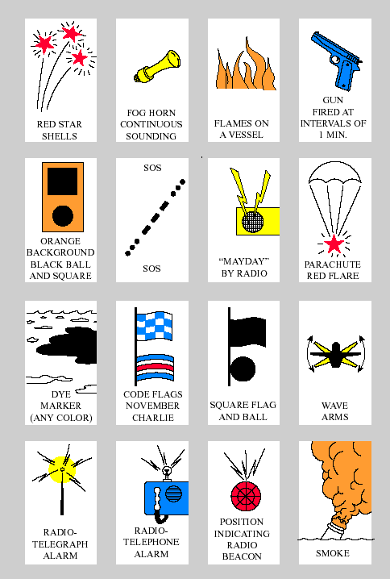
Options for getting help
Shown at left are 16 approved distress signals (International Rules)
A high intensity white light flashing at regular intervals from 50 to 70 times per minute is also approved (Inland Rules)
Notes:
Nav Rules available at http://www.navcen.uscg.gov/?pageName=navRulesContent#37.

Slide 34
Options for getting help
In practical terms, the options narrow to radio, cell phones, waving arms, and flares
Each has advantages and limitations

Slide 35
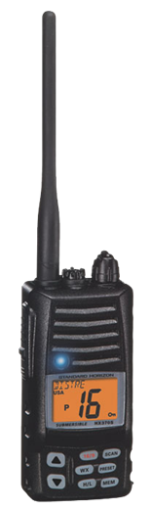
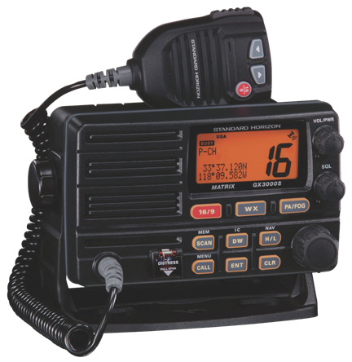
VHF Marine radio
Preferred method in most areas channel 16 monitored by US Coast Guard, Law Enforcement, and most boaters
Courtesy of Standard Horizon
Notes:
Remind the attendees that VHF-FM is line of sight. It is a party line, which has advantages because other boaters may be nearer to you than either the Coast Guard or other government agencies. Time permitting, ask some of the attendees to simulate giving a distress call. Although the use of preferred phraseology is desirable, mention that what is important is that content is what is important. The right help will be there sooner if they know the nature of distress, location, and other things noted above.

Slide 36
How to make a distress call
“Mayday, Mayday, Mayday” on channel 16
State “This is” Name of boat (repeat 3 times)
Give description and location of boat
Nature of the problem, number of persons on board (POB), local weather and
Any medical conditions
Notes:
Time permitting, you can go over this and have the students simulate giving a Mayday message.

Slide 37
Digital Selective Calling
Notes:
This video is used with the kind permission of the Florida State College at Jacksonville, FL.

Slide 38
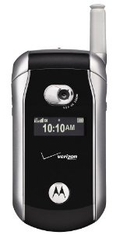
Cell phones
Potentially valuable tool, particularly in areas without CG presence
Not recommended as primary means to call for help
  Only the person you call hears you
  911 operators may have limited experience with marine emergencies
  Helpful as backup
Notes:
Cell phones may be useful, particularly in areas not normally served by the Coast Guard. Calling ‘911’ is one option, but many 911 operators have limited experience in dealing with marine emergencies. The Coast Guard Fifth District offered the following (http://midatlantic.coastguard.dodlive.mil/2012/12/on-the-water-and-in-distress-use-your-vhf-not-your-cell/): Cellular devices seem capable of doing almost anything thanks to the advent of smartphones and downloadable applications. This versatility and cell phones’ portability are leading many recreational boaters to have too much faith in them as the sole means of communication on the water, especially in emergency situations. “Cell phones may have gaps in coverage, especially in coastal waters,” leading to dropped calls and bad reception, explains Dennis Sens, the Fifth Coast Guard District’s Boating Safety Program Specialist. Though some phones are equipped with GPS transmitters, that capability may be misleading when it comes to locating a vessel in distress, says Sens.“Even if cell phones have a GPS transmitter, tracking down a cell phone signal is a very involved process. We don’t have that capability in our command centers, and that information is not easily obtainable from the cell phone companies—if they do have it—because of privacy concerns. All this research takes time, and during this process, things are happening on the water.” Even though VHF-FM radios are not required by law to be carried on board a boat, the CG recommends all recreational boaters, even in the smallest vessels, not leave the dock without VHF-FM and use it at the first sign of distress. Calling 911 with a cell phone should not be ruled out in case of an emergency, but using a VHF-FM for distress calls is a surer way to get the help you need, faster.

Slide 39
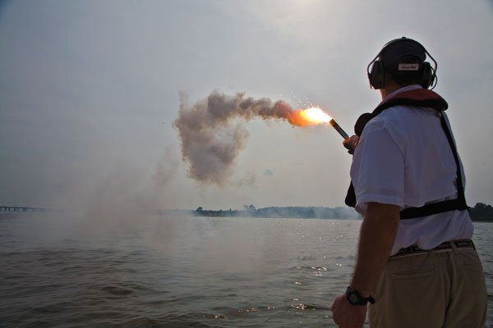
Use of flares
Wait until you see help before using
The surface-to-surface sighting range on water is ~ 3 to 5 miles
May not be effective in daytime
Flares generate considerable slag; hold them well overboard and at an angle
Photo courtesy of BoatUS
Foundation
Notes:
The first point notes that using ‘one shot’ devices is not likely to be useful if you cannot readily see help. Otherwise it is a waste of the flare. Hand held flares (often carried by recreational boaters) can be used day and night, but tests by Boat US indicated that these were not great at capturing attention (see http://www.boatus.com/boattech/articles/pyrotechnics.asp). When using these make sure that you hold them at an angle from you and away from the boat because these generate hot slag. These flares have an expiration date. BoatUS found that some expired hand-held flares were very hard to ignite or didn't seem to burn as brightly as they should, and meteor flares that didn't fly as high or burn as long as advertised claims. However, both BoatUS and the Coast Guard believes that expired pyrotechnic devices are good for backup.

Slide 40
Some evolutions you should prepare for

Slide 41
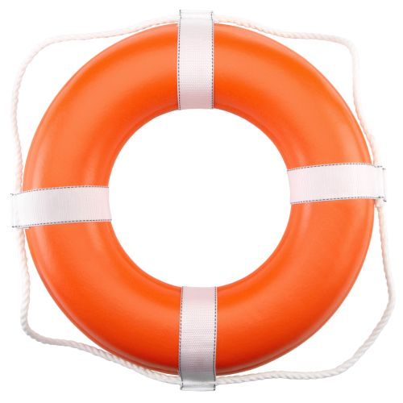
Man overboard
Both urgent and critical
Steps:
  Yell ‘man overboard,’ reduce speed
  Assign person to keep pointing at person in the water (PIW)
  Throw life ring or anything that floats
  Return to PIW; approach from downwind/current
  Shut off engine
  Retrieve person over side or stern
Notes:
There is a great deal of published information on this procedure for both sail and powerboats (see e.g., http://www.boatingsafety.com/nzcg/recovery.html, http://www.rorc.org/general-conditions/man-overboard.html, http://www.uscg.mil/d13/cfvs/docs/References/RiskMgmtManOvdb409.pdf, http://live.cgaux.org/?p=523, or http://www.thefishingline.com/man.htm). It’s much easier in a powerboat than a sailboat, but possible with either. The likelihood of success/survival depends upon many factors, but time is critical. This is something that should be practiced. If possible, find someone who has a weighted dummy, rather than just a life preserver to simulate the person overboard. This increases the realism of the simulation and makes it clear just how difficult it is to recover someone (particularly if the person is not conscious) over the stern of the boat. Consult the Auxiliary Boat Crew Manual for more information (http://www.uscg.mil/directives/cim/16000-16999/cim_16114_5c.pdf).

Slide 42
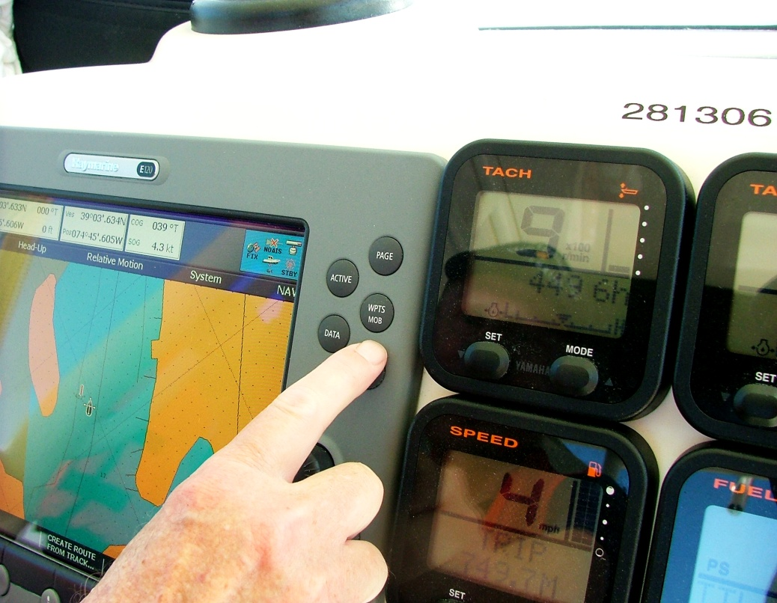
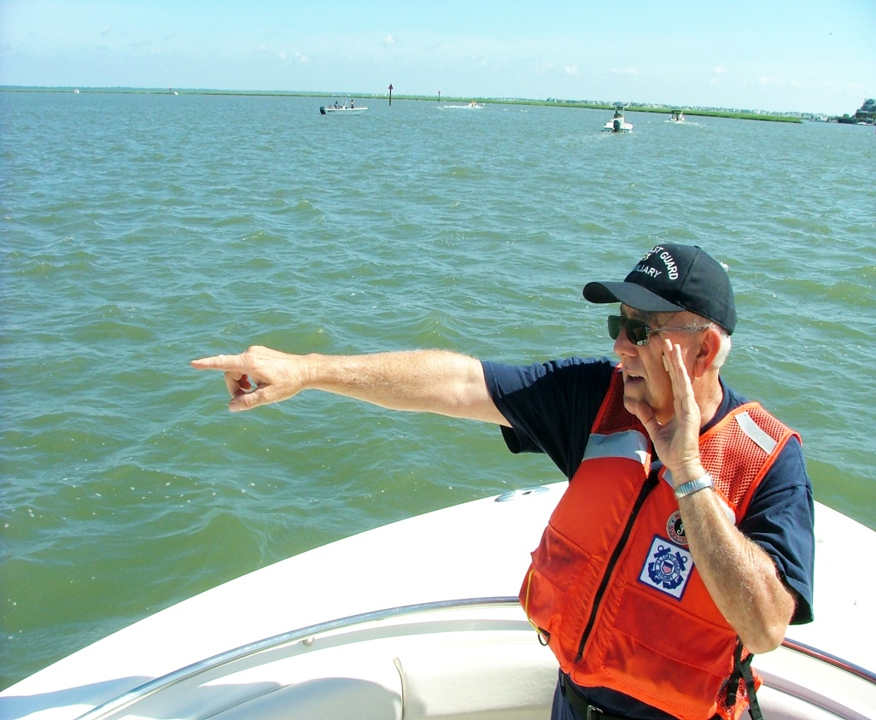
Hit the MOB button on the GPS if so equipped
Have someone keep
pointing at PIW
Notes:
Auxiliary crews practice MOB evolutions routinely. These photos were taken by Joseph Giannattasio Public Affairs Specialist III (PA III) District 5NR. Auxiliarists in this crew included: Richard Weiss (Coxn), Irene Mead, Donald Dobson, John Tredinnick (all members of 053-08-02). [OPFAC 281306]
Location: Back-Bays and Channels of Avalon, NJ.
Date: All photos taken 06 JUL 2013.
Mention that the function of the MOB button on the GPS or chart plotter is to enable the boat to return to the location where the person entered the water.

Slide 43
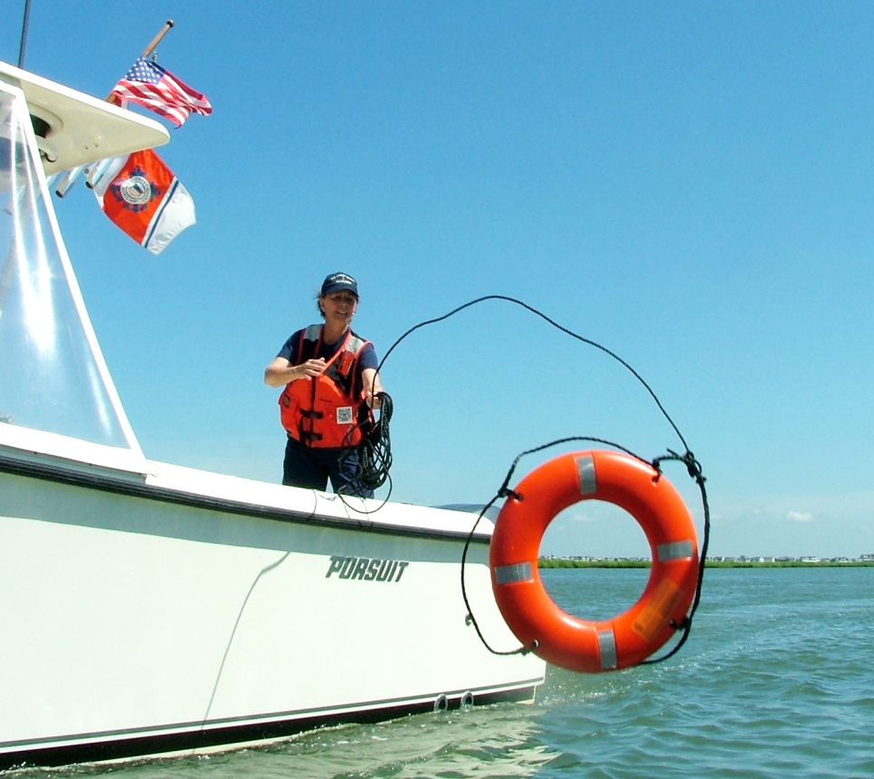
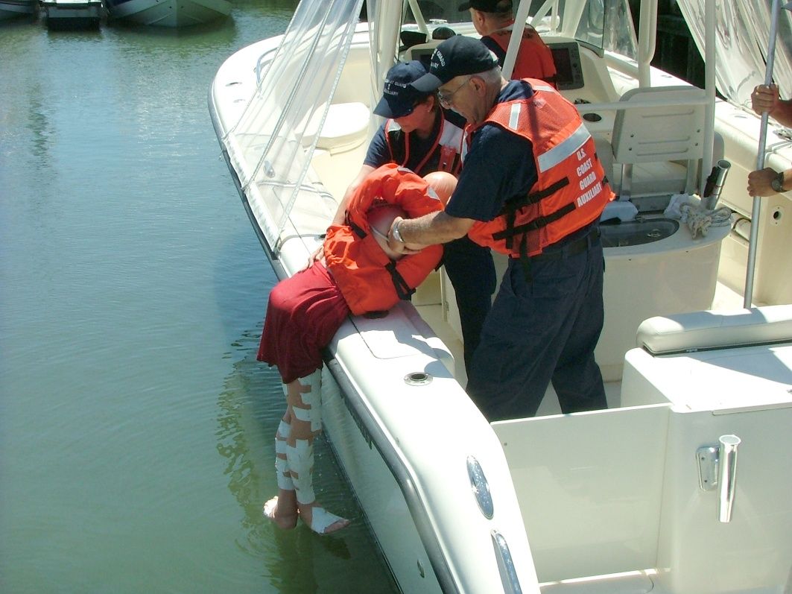
Throw a life ring or
anything that floats
Retrieve person over
side or through stern

Slide 44
Running aground
Check for possible injuries if impact substantial
Check for damage (hull damage turns inconvenient into critical and urgent)
Don’t try to ‘power off,’ you may make it worse
Consider setting an anchor to prevent going further aground
Notes:
There are numerous references on procedures after running aground (see http://www.boatsafe.com/nauticalknowhow/aground.htm, http://www.inyourfootsteps.com/sailing/tips/35/168/re-floating_techniques_after_running_aground/?TOP_THIRTY=True, http://suite101.com/article/running-a-boat-aground-a28069, http://www.boatplace.com.au/index.php/component/k2/item/187-how_to_avoid_running_aground_in_your_boat, http://www.boatingbasicsonline.com/content/general/8_8_a.php). This does not have to be covered in great depth (no pun intended), just focus on the key steps.

Slide 45
Running aground
If in tidal waters, see if you can determine the state of the tide (call the Coast Guard if necessary)
Removing weight from the boat may help (if you have a dingy to put it in)
Consider getting commercial assistance (neither the Auxiliary nor the Coast Guard will tow off a grounded vessel in most cases)

Slide 46
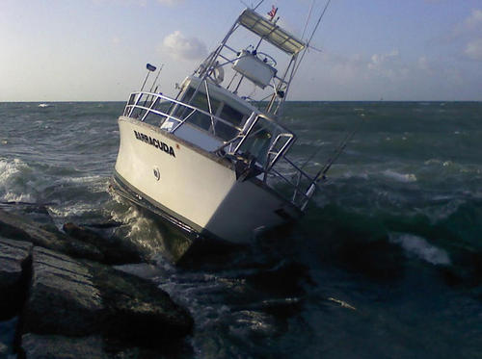
Running aground
Two broad cases:
  Soft aground; self rescue might be possible, damage minor
  Hard aground; help will be needed, damage could be major
Notes:
PORT ARANSAS, Texas - The recreational boat Barracuda sits hard aground on the Port Aransas south jetty, Aug. 25, 2012. The captain of the grounded boat contacted Sector Corpus Christi with his VHF radio at 4:55 a.m., stating his 38-foot recreational boat, the Barracuda, was aground on the Port Aransas south jetty with six people aboard. Source; http://cgvi.uscg.mil/media/main.php?g2_itemId=1745498. This looks to be hard aground, running on the rocks could mean hull damage. Damage to props and shafts is also likely.

Slide 47
Collision
Check for possible injuries if impact substantial
Check for damage
Assist other vessel if you can
It may be necessary to report the accident to State or Federal authorities (check regulations)
It is likely that you will need help
Notes:
Some collisions are no more serious than ‘fender benders.’ But more serious collisions sometimes present difficult choices. If you’re trying to administer first aid for one of the passengers, you still need to pay attention to other problems, such as water rising in the bilge. If someone else is qualified, you can tell them to take the controls…or tell them to get and operate a spare bilge pump or bucket and start bailing. If a passenger’s injuries are not life threatening, you should focus your immediate attention on moving your vessel out of the way of a large oncoming merchant ship, etc.
It may not be your first priority, but you should get pictures of the accident if possible. These will help accident investigators and may prove useful for insurance purposes and/or possible litigation.

Slide 48
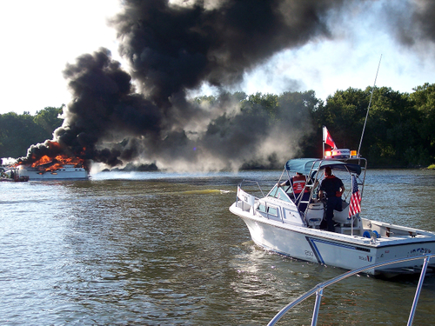
Fire
Fire is potentially a major issue on a boat
Fire is not a major cause of fatalities, because it is infrequent; nonetheless it is serious if it occurs
Notes:
Keokuk, Iowa - - Auxiliary Facility assists Missouri Water Patrol and local fire department with radio communications and controlling the area around a burning 47 foot vessel. Photo source http://cgvi.uscg.mil/media/main.php?g2_itemId=846583. As noted earlier: Perhaps surprisingly, fires are not a major cause of accidents, fatalities, or injuries in recreational boat accidents, accounting for (2012 data) 5.8% of accidents, 0.76% of fatalities, and 3.3% of injuries. Nonetheless, everyone aboard should know where the fire extinguishers are and how to use them. Fire may be infrequent, but it is serious when it does occur. You can’t simply step out of the burning boat and walk home. Nonetheless, resources are available and fires can sometimes be extinguished—particularly if caught early. By the time it gets to the size shown in this picture it’s simply a matter of taking the occupants off the boat and keeping other vessels out of the way.

Slide 49
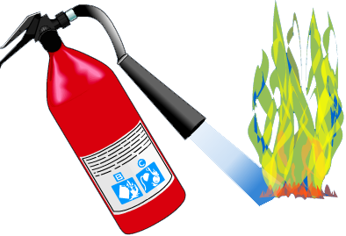
Fire
Shut off all engines, generators, and ventilation systems
Use available fire-extinguishing systems on boat
Initiate Mayday call on radio
All persons in life jackets and in a smoke and flame free area of boat
Pull pin
Aim at base
Squeeze handle
Sweep side to side
Notes:
This is covered in detail in the Boat Crew and Seamanship Manual (http://www.uscg.mil/directives/cim/16000-16999/cim_16114_5c.pdf).

Slide 50
Fire
If life raft or dingy is available put it over the side and inflate it
If boat has a built-in CO₂ system, after fire is out, allow time for concentrations of CO₂ to ventilate to the atmosphere before entering
Never enter a compartment after a fire until you are sure it has been properly ventilated

Slide 51
Fire
Abandonment is last resort, but should be considered particularly if
  Crew are becoming trapped by the flames
  There is no longer the equipment to fight the fire
  An explosion is likely (flames by the fuel tanks) or
  Similar life threatening situations are apparent

Slide 52
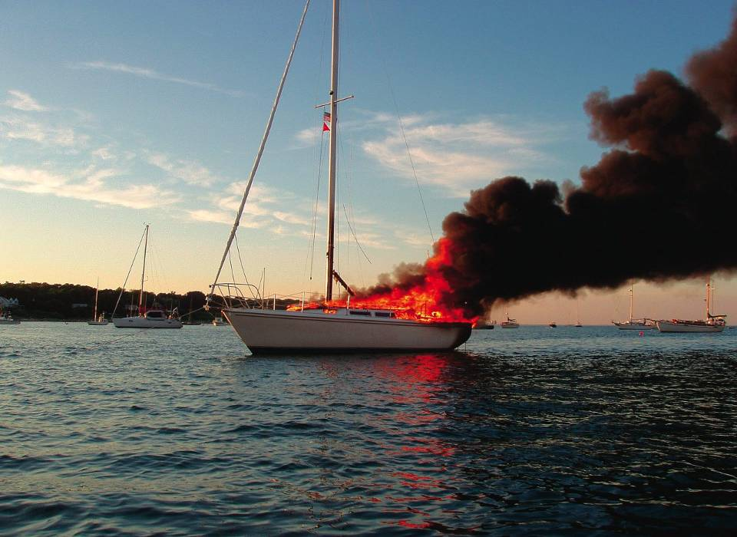
Sometimes it is necessary to
abandon the boat
Photo courtesy of
BoatUS
Notes:
This photograph illustrates a case where further fire fighting efforts are not likely to succeed. Staying on board would be foolish in this case.

Slide 53
Accident reporting
Marine accidents need to be reported if
  Property damage exceeds $2,000
  Someone is fatally injured or if treatment beyond first aid is required or
  Someone disappears
Notes:
This can be covered quickly. Each State has its own reporting requirements and the time frames for notification vary with the severity of the accident. Details are available at http://www.uscgboating.org/safety/accident_reporting.aspx.

Slide 54
Summary and closing comments

Slide 55
Key response steps
Detect
Evaluate
Take
action
Seek
help?
Prioritize
Stabilize
Monitor
situation
Sequence of steps may
depend on case
Reassess?
Notes:
This is a useful slide to review the key steps in response. Ask the students to provide a brief discussion of each of the steps as a review.

Slide 56
Preparation is key
You may never be “Suddenly in Command,” but relying on luck is foolish
Learning and practicing what you need to do in this situation will increase your safety, confidence, and enjoyment
Learn something from every trip
Notes:
The skills you learn in preparing for this possible emergency will also make you a better first mate or co-pilot.

Slide 57
What now?
Take additional boating courses
Check equipment aboard by having a free Vessel Safety Check
Learn how to operate the boat
Learn how to pilot (navigate) the boat
Prepare/review checklists appropriate for your boat
Practice, practice, practice!
Notes:
Some people are reluctant to learn from their ‘significant other’ (SO) or other family members. And, just because someone knows how to operate a boat does not mean that they know how to teach others how to operate a boat. Fear that you may damage the boat may keep you from learning. A practical suggestion is to find someone else to teach you. There are numerous schools that will provide on the water training—an option you might consider.

Slide 58

Questions & Answers

